Slide 1
Hexagonal architecture
Rasika Samarakoon
Notes:
9am start

Slide 2

Clear up the fog…
Micro Services
Domain Driven Design
Micro Kernel Architecture
CQRS
Layered Architecture
Event Sourcing
Hexagonal Architecture
Actor Model
Behaviour Driven Development
Test Driven Development

Slide 3

Clear up the fog…
Micro Services
CQRS
Layered Architecture
Actor Model
…
TDD
BDD
DDD
Set of principles and guidelines to design and model complex domains.
Handle complexity in the heart of software
Key principles
Ubiquitous language
Bounded context
Strategic designge
Bounded context
Development approaches
Architectural Styles or patterns
Can be used with/without Domain Driven Design
Ex: Micro services – way of implementing bounded context
Ex: Event sourcing – way of modeling domain

Slide 4
Layered architecture
Decouples layers. Separation of concerns.
Each layer provides services to
the layer above.
Each layer knows only about layer
immediately below it
With contracts(interfaces) layers
can be easily swapped out.
Presentation Layer
Domain
Entities
Business Layer
Persistence Layer
Database

Slide 5
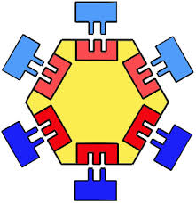
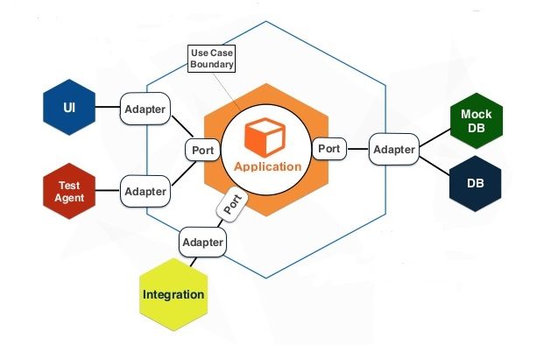
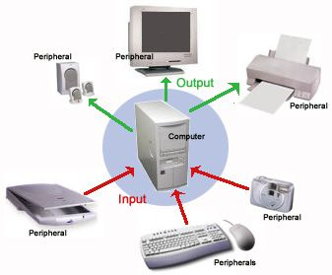
hexagonal architecture(ports and adapters)
Special form of layered architecture
Loose coupling and separation of concerns
Inner layers do not know about outer layers
Keeps all inputs/outputs to the system apart
Keeps technology concerns/infrastructure apart

Slide 6
hexagonal architecture(ports and adapters)
Domain is isolated agnostic to outside world
More Modular, Understandable and maintainable application
Domain can be tested in isolation. Easy to mock things. Test the behaviours exposed.
Adapters are easily replaceable(Technology changes, new versions of frameworks)
Seems a good fit for integrations(Clean, easy to add new services)
Easy to change communication protocol.
Applications do not become legacy

